Slide 1

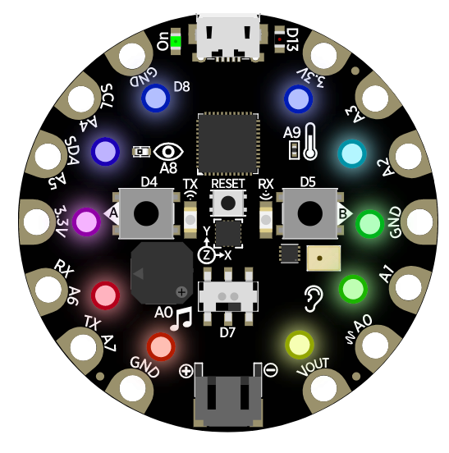


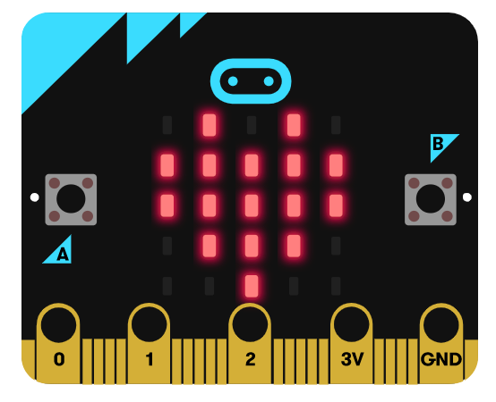
TIME | STREAM
9 AM PST 12 PM EST | MakeCode for the micro:bit (on break)
10 AM PST 1 PM EST | MakeCode with Minecraft (on break)
11 AM PST 2 PM EST | MakeCode Arcade (on break)
1 PM PST 4 PM EST | MakeCode Arcade (Advanced)
2 PM PST 5PM EST | MakeCode in the Kitchen (Friday only)

